Slide 1
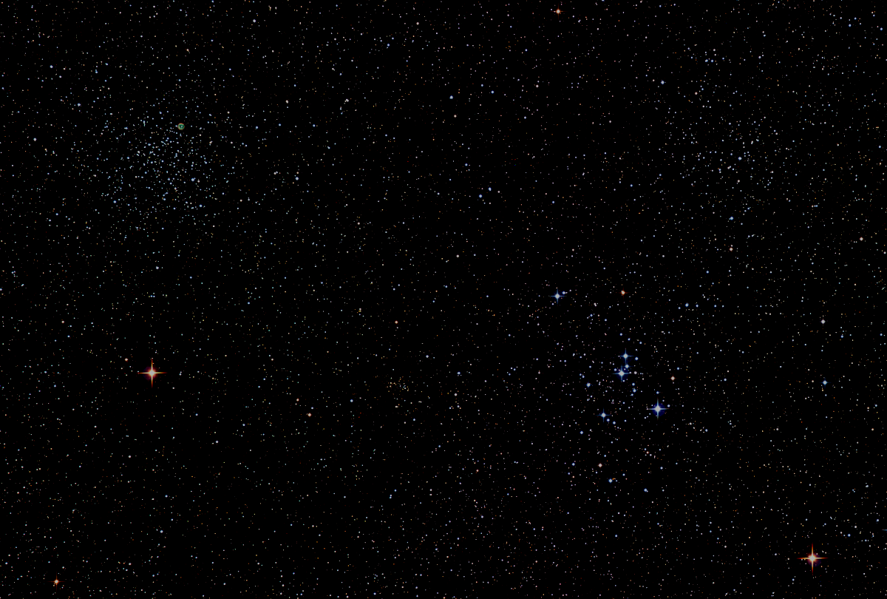

Howard
Astronomical
League
17
March 16th, 2017

Slide 2
Introductions
Notes:
Favorite star party - regional or HAL

Slide 3
HAL Social Media
Website:
http://www.howardastro.org
Facebook:
https://www.facebook.com/groups/howardastro/
Yahoo Group (mailing list):
https://tech.groups.yahoo.com/group/howardastro/
Notes:
Mention the HAL Yahoo group has over 400 members, and the Facebook group has 282 members. Obviously, not all of those folks are HAL members, but they are all astronomy enthusiasts

Slide 4
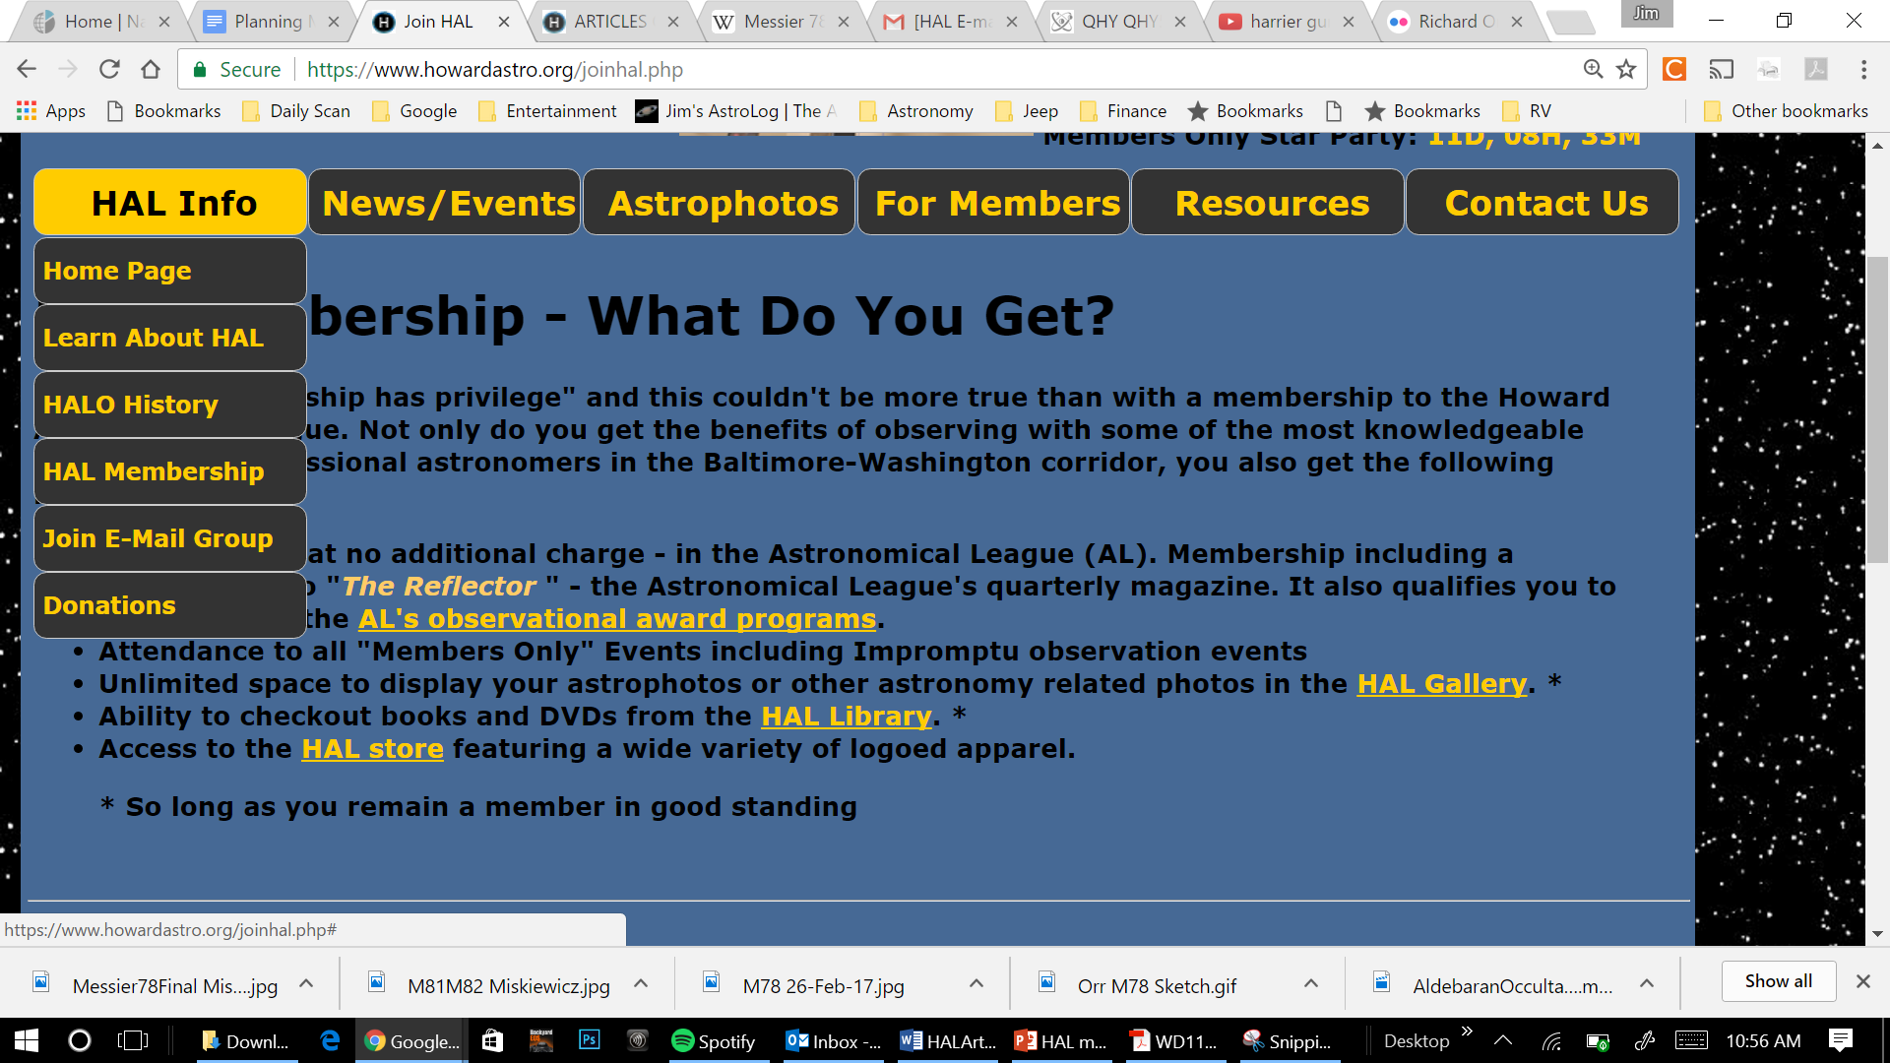
HAL Library Online
Notes:
Ron Schwartz sent me the most recent Excel spreadsheet of the HAL Library contents yesterday. I have now replaced the previous library database contents with the new file. You can check it out on-line now via your HAL website log-in. In this version we are up to 175 books, CDs, or DVDs.
My next step, which may take a week or so, is to create an edit capability so that library staff members can add, modify, or delete library contents. This would include the capability to edit the fields that show that a book has been checked out, when, and by whom.
Once that is up and running we can discuss how a member interface with the database should work that will allow members to initiate the check-out process.

Slide 5
Congratulations!
Dennis Conti’s coordination of the American Association of Variable Star Observers (AAVSO) amateur observations in support of a major Hubble Study of 15 exoplanets is mentioned on page 70 of the April 2017 edition of Sky and Telescope.
Dennis, who is chairman of the AAVSO Exoplanet Section, will be speaking to us at the May meeting about Exoplanet Detection via Microlensing.

Slide 6
Upcoming Events
March 22nd - 26th Chaos Springs, VA
March 25th - Members only star party, Alpha Ridge Park.
April 8th - Public star party, Alpha Ridge Park.
April 12th - Yuri’s Night, RNC

Slide 7
Night Sky Summary
Sun is at Spring equinox at 6:28am on March 20th.
Moon: |◐ Mar 20|⚫ Mar 28|◑ Apr 3|⚪Apr 11| Best earthshine view is around Mar 31.
Planets: Venus is just ending an evening apparition and becomes a morning object March 25th. Look for it to brighten during the next month and rise earlier each morning. It appears as a waxing crescent, decreasing in apparent size. Find Mars continuing to hang on in the western sky after sunset. Jupiter reaches opposition on April 7th, quickly becoming more favorably placed for evening viewing. Saturn is a morning object rising shortly after dawn, headed toward opposition in June.
Constellations: Cancer, Leo, and Ursa Major are near the zenith at sunset.

Slide 8
Observing Challenge
Bi-daily Observations of Venus
Venus reaches inferior conjunction on March 25th as it ends its present evening apparition, and passes into the morning sky. On this particular conjunction, Venus will be near its maximum ecliptic latitude, meaning that it will be about 8-degrees north of the sun. In this configuration, bi-daily, or morning and evening of the same day, observations of Venus are possible within a few days of the conjunction. Look for it about 30 minutes before or after sunset.
Look for reminders that this opportunity is coming, get out and observe, and look for a call for your observations just prior to the April meeting.
Notes:
March 25th is HAL’s Member’s only Star Party – attempt to spot Venus on that morning and come out to see it again at the star party.

Slide 9
Education, Public Outreach and Research at a Small Observatory
Elizabeth Warner
Director, UMD Observatory
Notes:
Elizabeth has pursued a lifelong love of astronomy as an amateur astronomer. Professionally, she worked for nine years at Melton Memorial Observatory in Columbia, SC where she was known as “Telescope Goddess”
She is presently director of the UMD Observatory, which was dedicated in 1964 and was established as a teaching facility. A public program was added and those Open Houses continue today. While maintaining the existing educational and public outreach portions, Elizabeth has also established new outreach initiatives since taking over in May 2002. A challenge from a student and a change in the program she mentored led to starting a research program with undergrad students.
She has been published in Sky and Telescope, and Space Science Reviews regarding her public education and outreach support to the Deep Impact comet mission. She she has earned BS and MS degrees in Physics at University of South Carolina.
As I began lining up 2017 guest speakers, Elizabeth received my first invitation. This is driven by my desire to find new and interesting ways to use HALO to support HAL’s mission.

Slide 10
Member’s astrophotos
and sketches

Slide 11
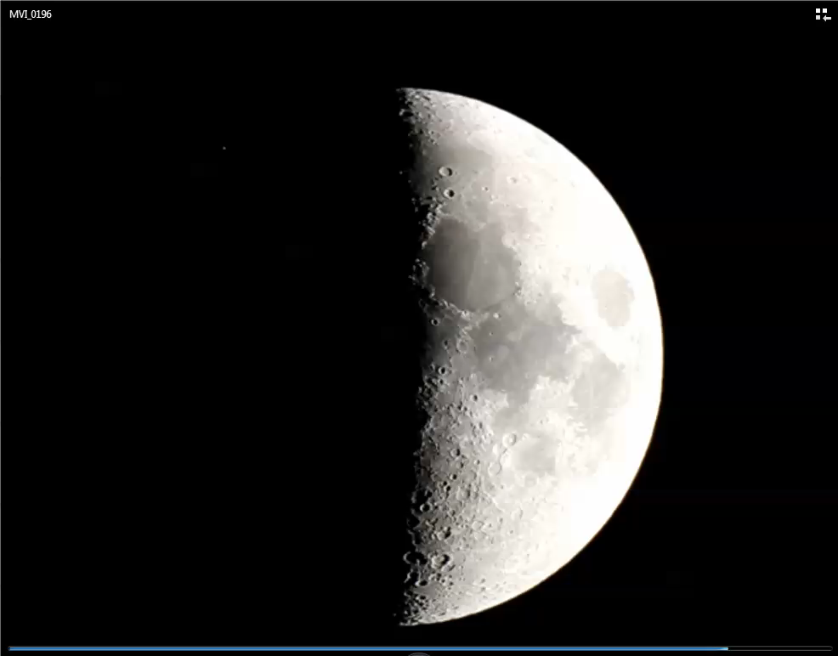
Notes:
Moon occulting Aldebaran on March 4 at about 11:05pm EST
HAL’s March Public Star Party

Slide 12
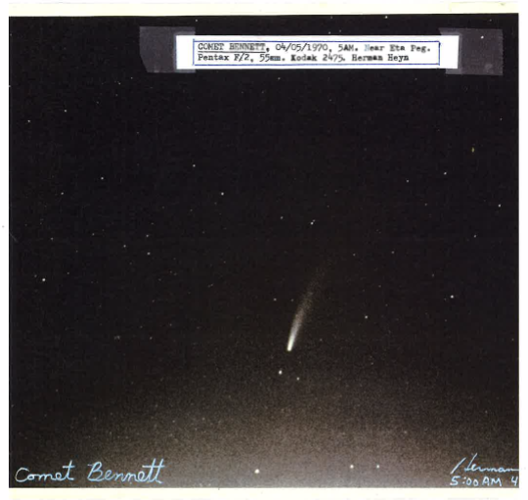
Herman Heyn, Comet Bennett, April 5, 1970
Notes:
Richard Orr

Slide 13
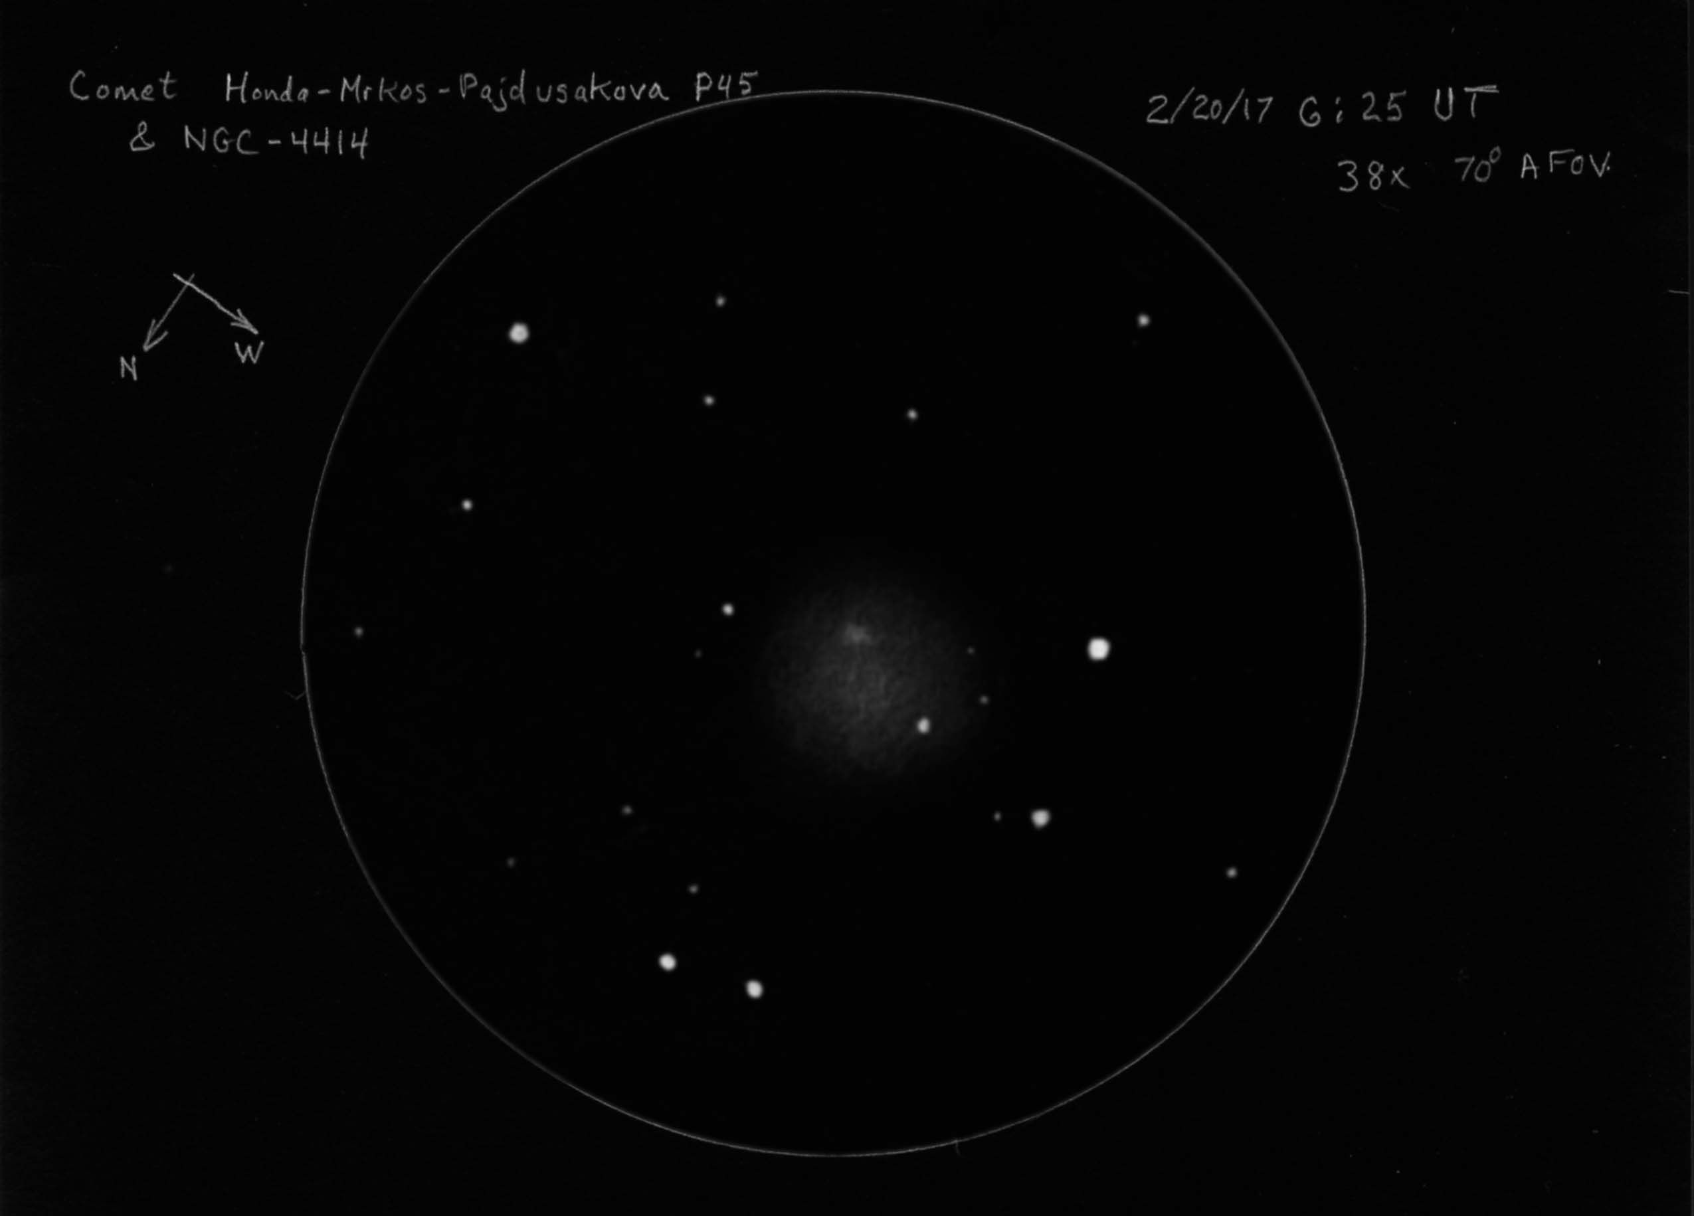
Notes:
Gary Frishkorn - observations were made with a home-built 6" binocular. The pencil sketch was scanned and inverted.
Attached is a pencil sketch I made last month of comet P45 (Honda-Mrkos-Pajdusakova). The comet is the large, round diffuse object slightly below center. The smaller, more intense object at center is galaxy NGC-4414 shining through P45's coma! Initially, unaware a galaxy was in the field, it was assumed to be the comet. But when it hadn't appeared to move in nearly an hour, charts were checked more carefully. Finally, it was recognized there were actually two objects. And after about another hour of observing, the comet's larger but far more difficult coma was detected moving westward in the star-field.

Slide 14
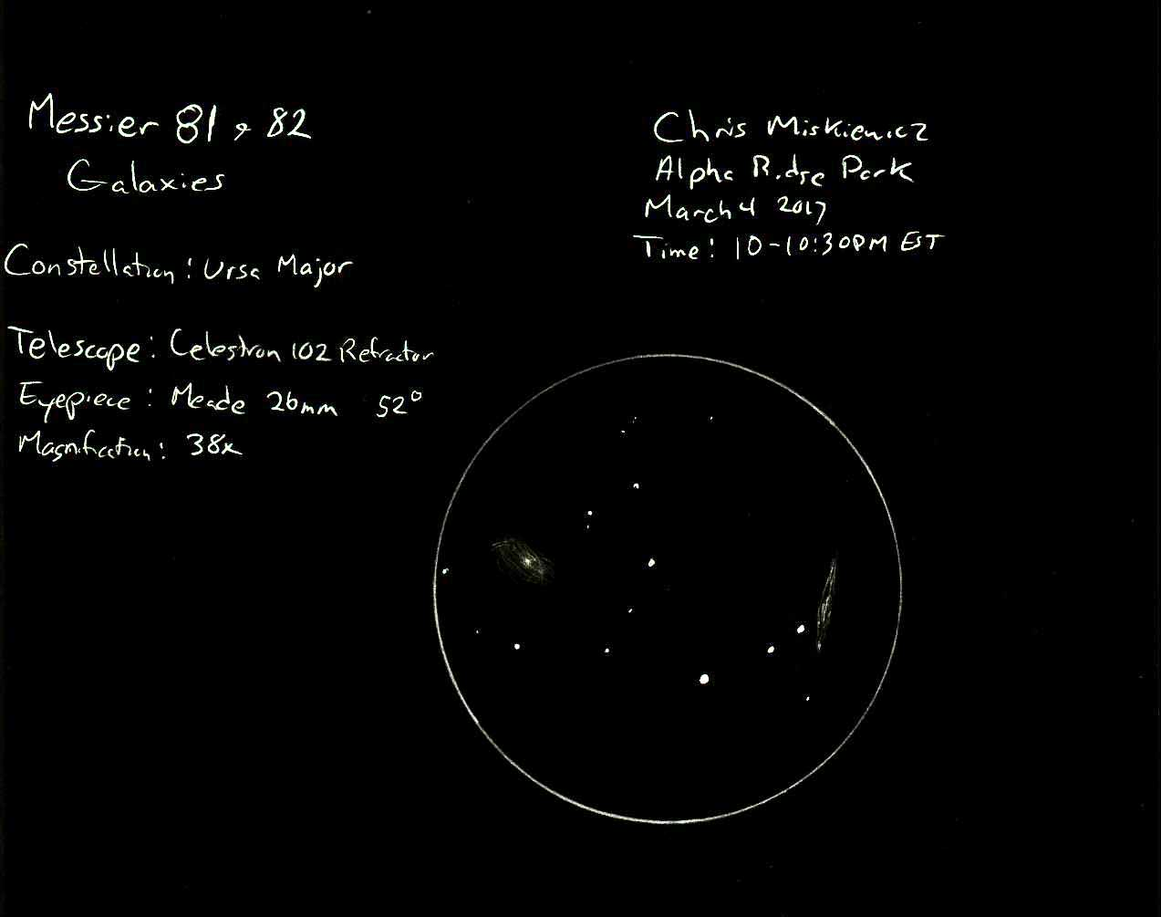
Notes:
Chris Miskiewicz – a few slow moments while hosting the HAL Public Star Party on March 4th.

Slide 15
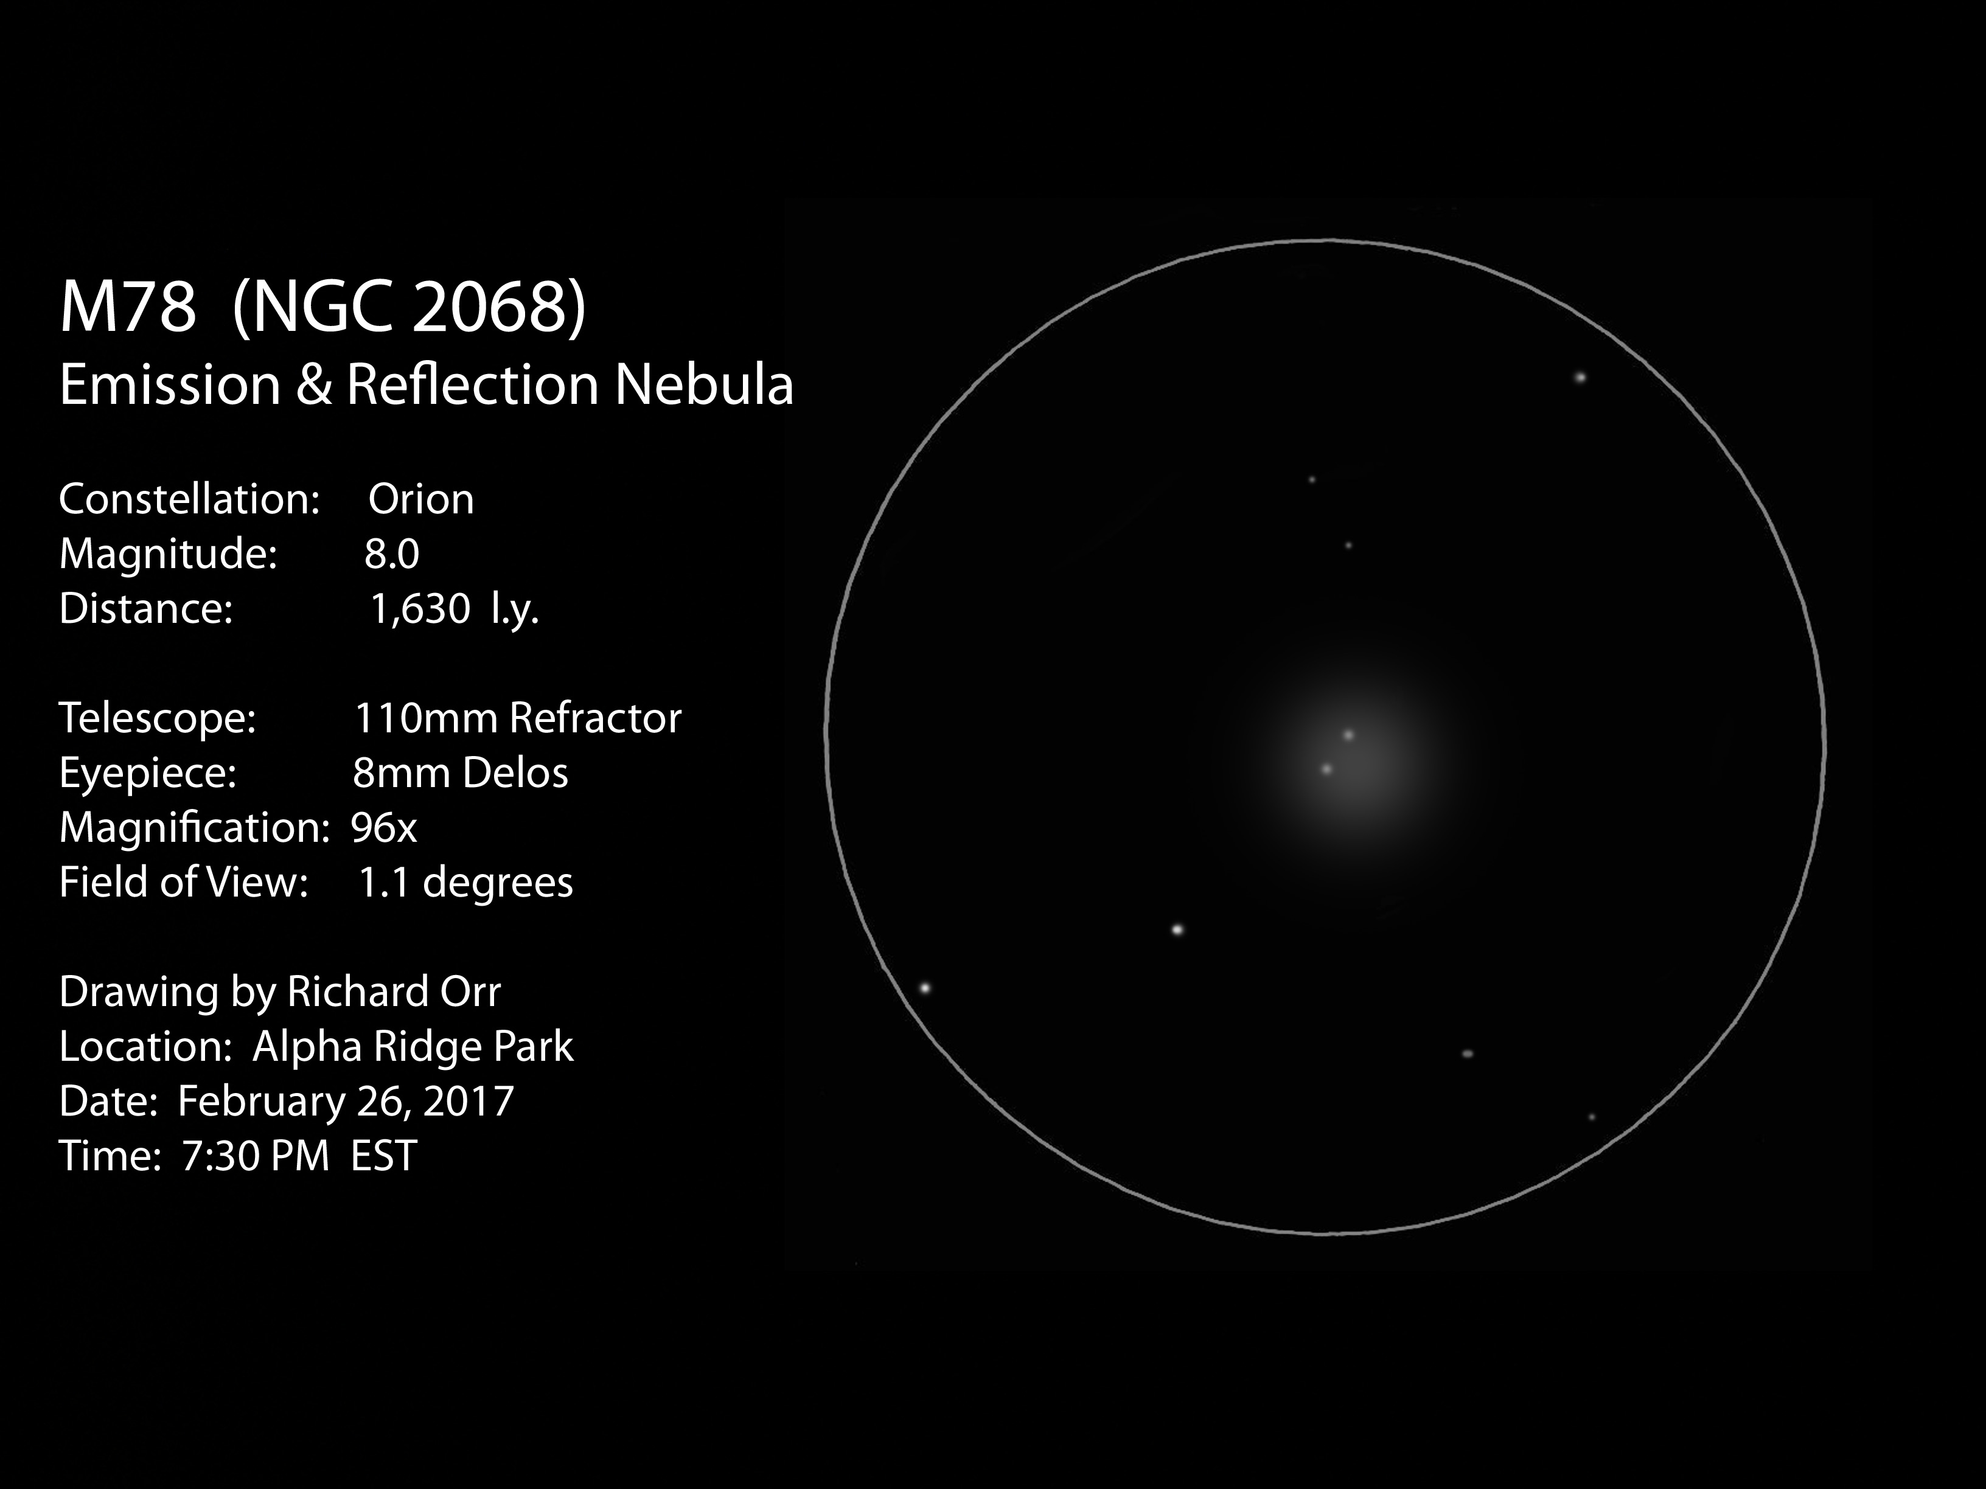

Slide 16
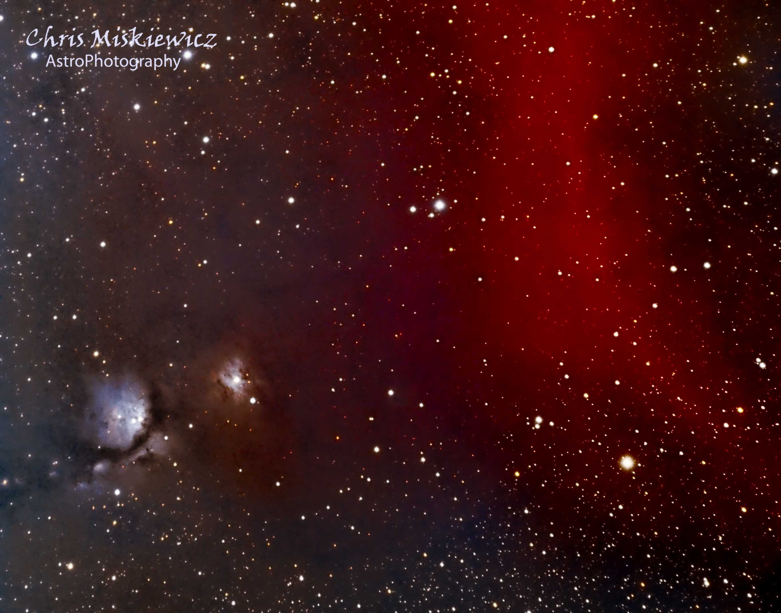
Notes:
Messier 78 and Barnard's Loop:
This was imaged during an impromptu back on Feb 20. Mike joined me at AR and the clear skies came and went with high thin clouds ruling most of the night. I imaged even with the clouds, collecting whatever photons I could with my QSI 683 and LRGB filters(5 min subs each channel x8). I tried collecting narrow band data but with Orion setting I only collected 2 Ha subs so I did not include them in this image. For fellow imagers, my equipment failed to dither correctly and only my Luminance Flats were collected so I had to create synthetic flats for the other channels and a lot of post processing

Slide 17
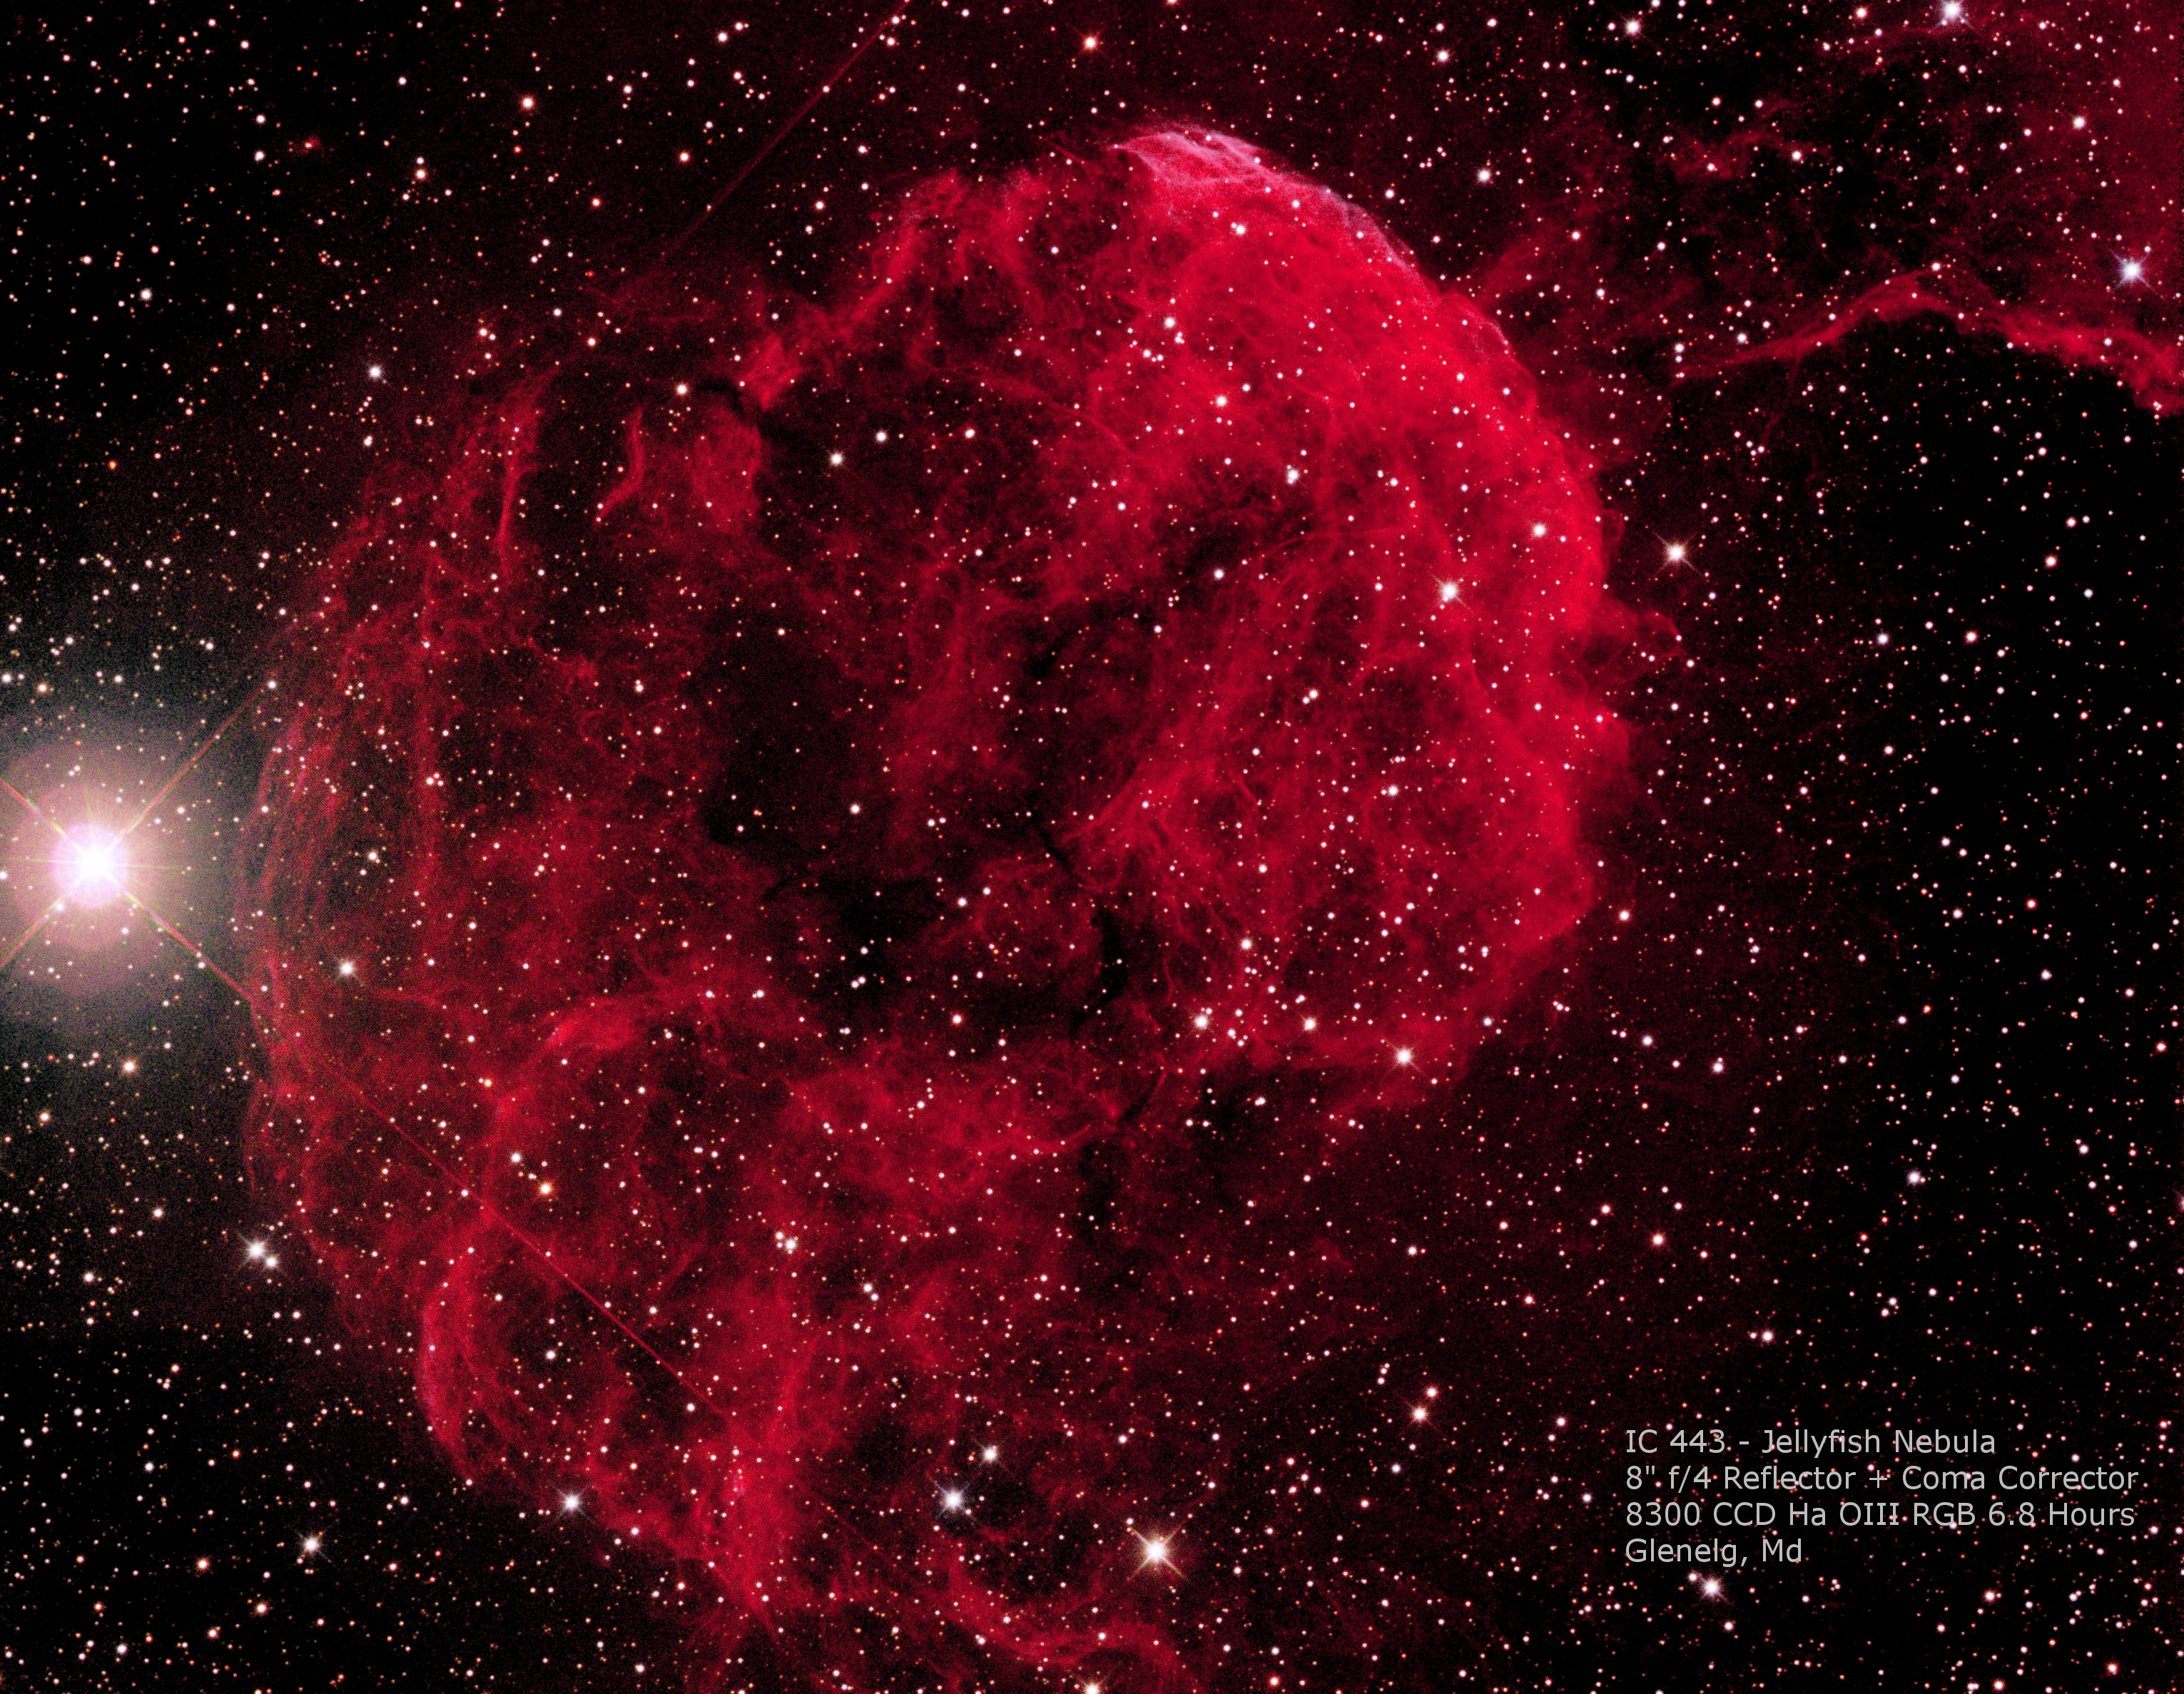

Slide 18
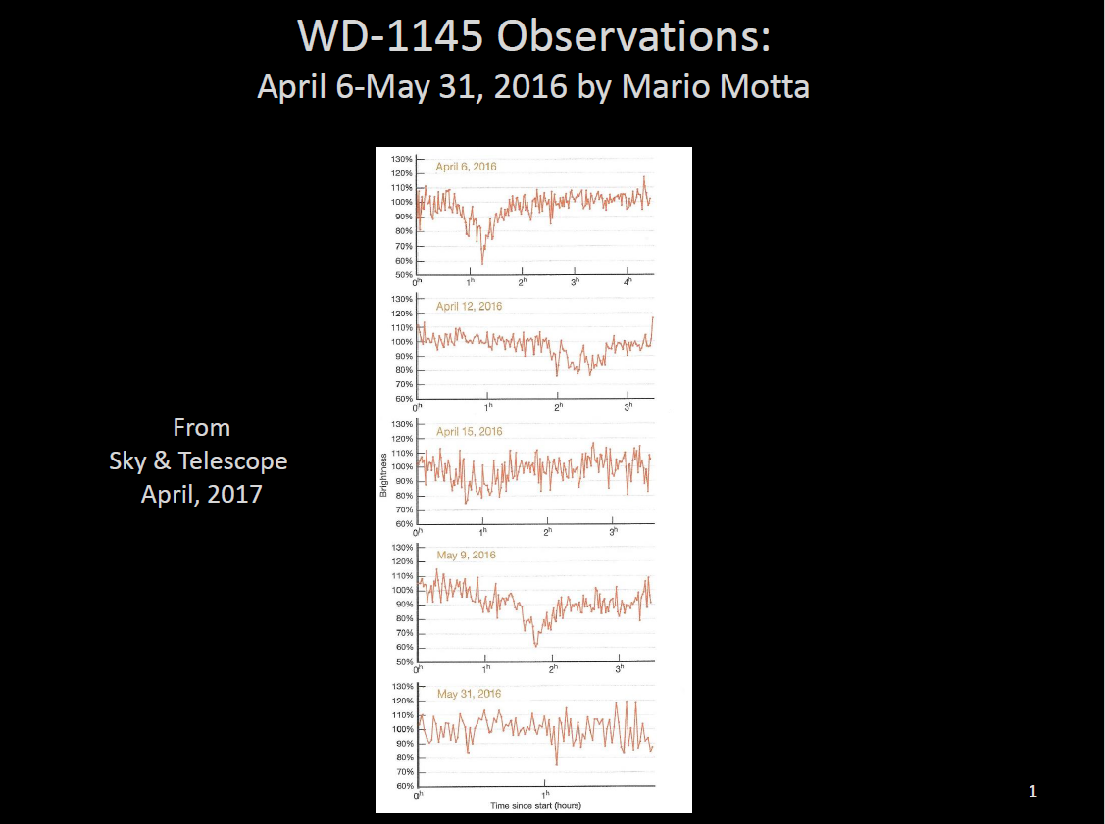
Notes:
The first slide represents the sequence of light curves of a disintegrating planetesimal, whose story was published in the latest Sky & Telescope issue by my friend Mario Motta (I had helped him develop these curves and, in fact, I had presented these at one of last year's HAL meeting). By the middle of last year, the object seemed to have completely disintegrated. Then, earlier this year, it (or some other object) was seen to come back! So, in early February, I was contacted by the principal investigator from Harvard about needing some amateur astronomers to observe this weird system on the night of February 18 at the same time he had time on Hubble to view it in the UV. So, I had amateurs lined up with from Boston to Chile. Unfortunately, I was the only one who was able to capture it due to weather issues at the other locations. So my light curve (second slide) was the only one of the group that he found useful!

Slide 19
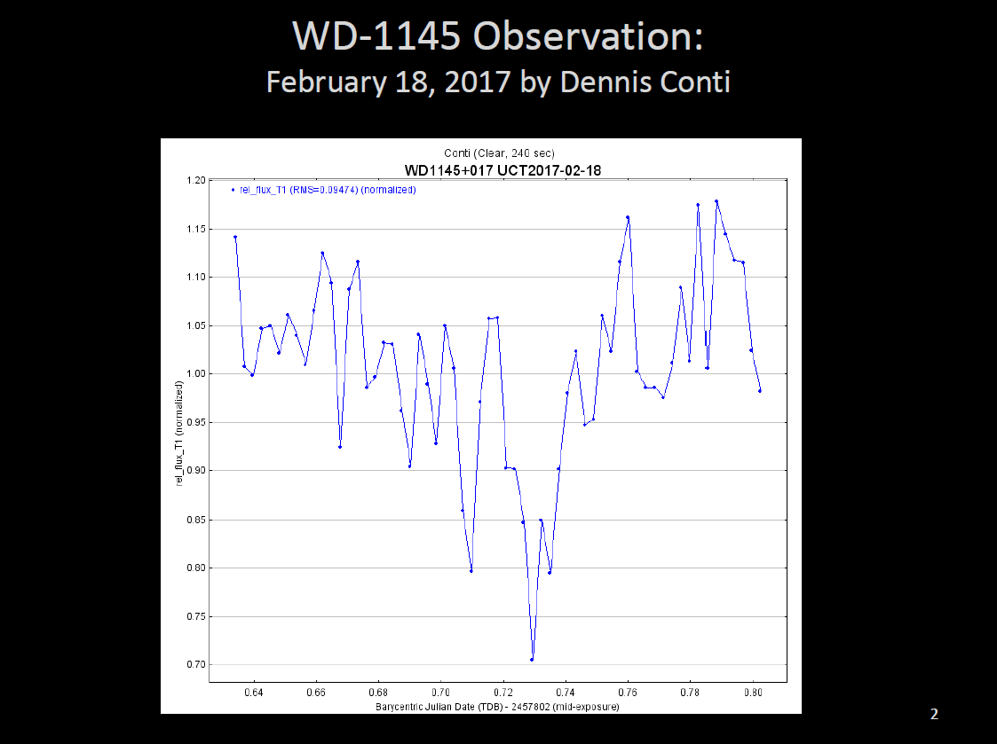

Slide 20
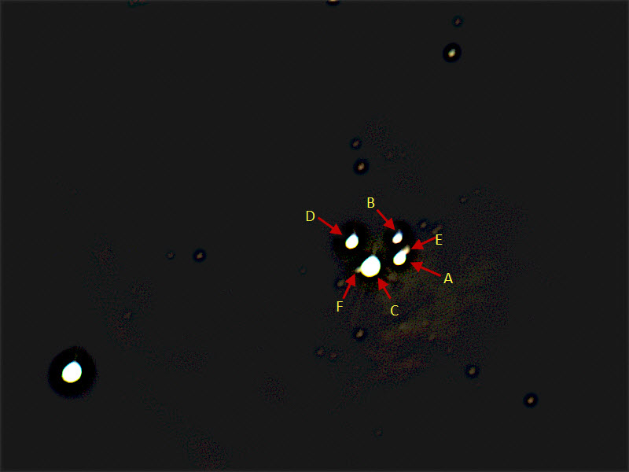
Trapezium in M42
Mike Krauss (mostly) and Jim Johnson
HALO/Watson Telescope with QHY5III290C
February 26, 2017

Slide 21
HAL Star Party Etiquette
Special Topic

Slide 22
Before you leave home...
Pack everything that you need
Batteries, cables, eyepieces, tools, camera(s), red light
Dress for the weather
More layers of clothing than you think you’ll need.
Bring snacks/drinks
Have an observation/photography plan

Slide 23
Consider the type of star party...
Public
Scopes set up by members to share views with the public and other members
Members Only
A member benefit
Members usually pursue personal observing/astrophotography programs
Scopes may or may not be available for sharing views
Impromptu
When that rare clear sky pops up!
Members only
Look for keyholder announcement (members, if opted in)

Slide 24
Once you arrive...
Select a space that works for you
Alpha Ridge vs. Carrs Mill
What do you want to observe?
Near the entrance if leaving early
With people or on a quiet edge
Turn off/cover trunk and door lights
Take advantage of the remaining daylight to set up
Take some time to get to know the people around you

Slide 25
Once it gets dark...
Enjoy that rare clear sky that you have waited so long for
Enjoy the company of like-minded amateur astronomers
Conversation is always welcome, but loud noise can be distracting
Protect your neighbors’ night vision with red lights/screen covers
Refrain from running automobile engines until you are leaving

Slide 26
When it is time to leave...
Parties generally end at 11pm
Host’s discretion, will announce
Maintain red light discipline of others are still observing, except…
Turn on headlights when driving out
Required for safety reasons
Let observers around you know so that they can cover up as needed
Do not leave cars in the park!

Slide 27
Most importantly...
Show up!
Jim-ism: 85% of life is showing up
Enjoy your evening
Star parties can be a heckuva lot of fun
Enjoy sharing astronomy with others
Rewarding - you’re hooked the first time that you amaze a youngster!

Slide 28
Astronomy Humor
You Matter.
Unless you multiply yourself by the speed of light squared. Then, of course...
You Energy.
E=mc²
Notes:
A collection of summer time showcase objects that are easy to star-hop to.

Slide 29
Thank You!
Next month’s meeting is on Thursday, April 20th, 2017 7 PM
Dr. Adam Szabo
Chief of NASA Goddard Space Flight Center's Heliospheric Phyics Labratory
The Earth and Solar Wind Science Observations of the DSCOVR Mission.

